Slide 1
Mainland Newspapers and Hong Kong Protests
Group 4: Yifan Huang, Xueru (Wilson) Xie, Che-wei Lin

Slide 2
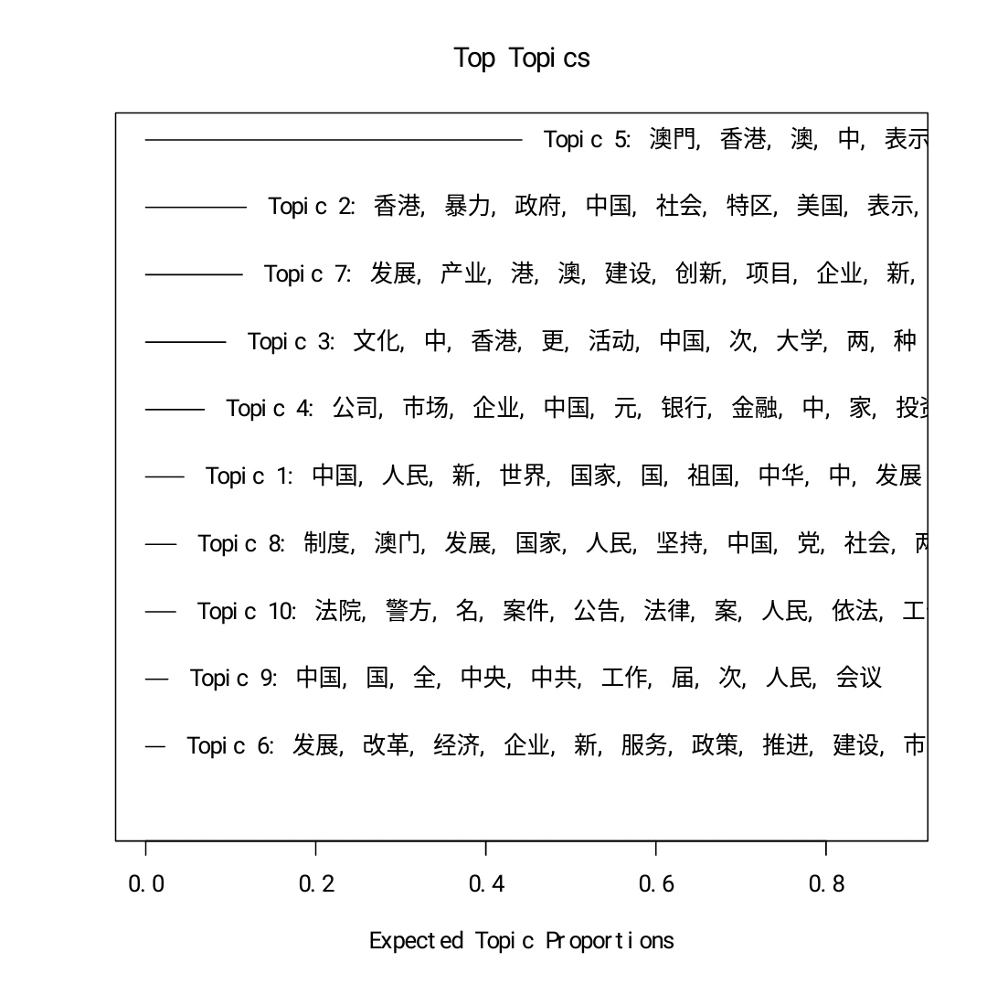
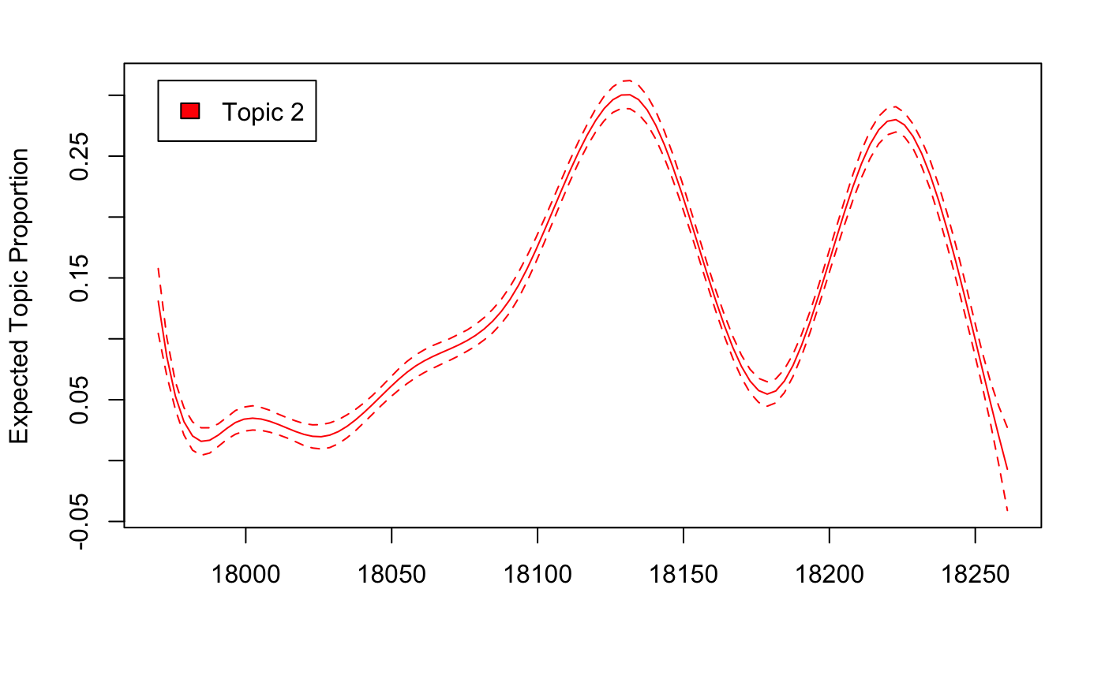
Of the articles about the protests, what are the main topics these papers cover?
Applying the STM model

Slide 3
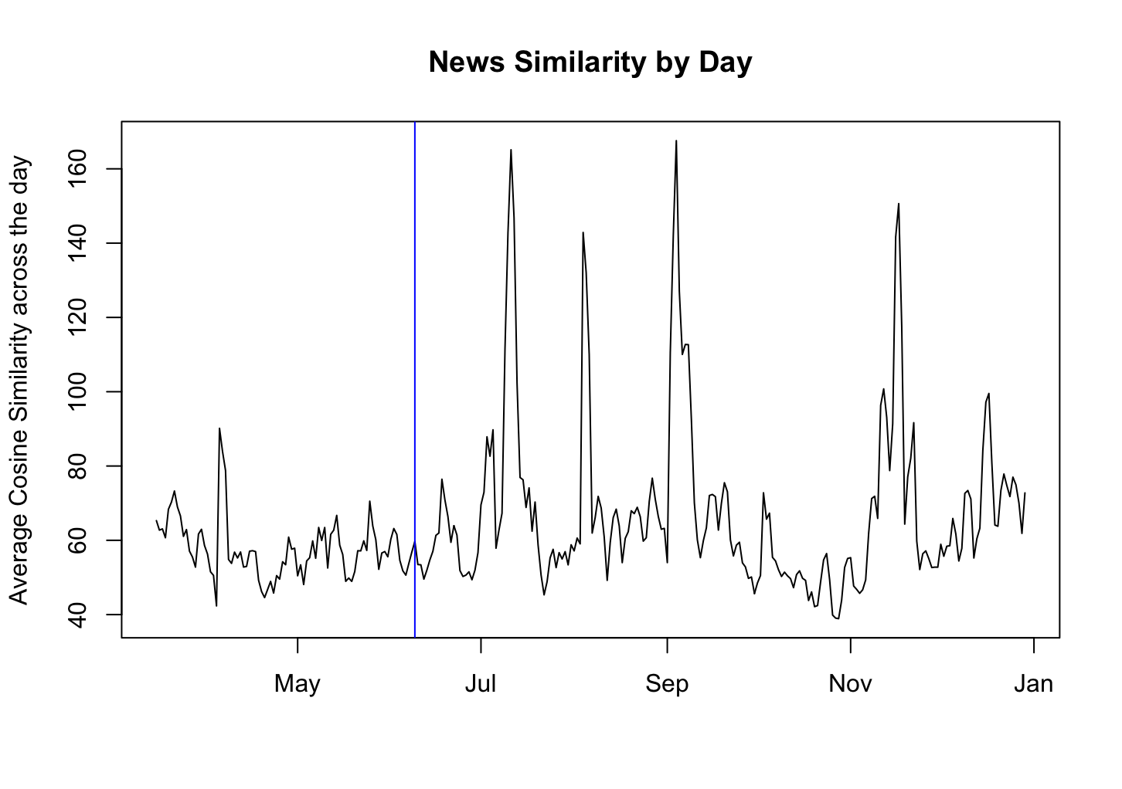
How much coordination is there across newspapers on the topic of the protest?
Similarity of news in each day

Slide 4
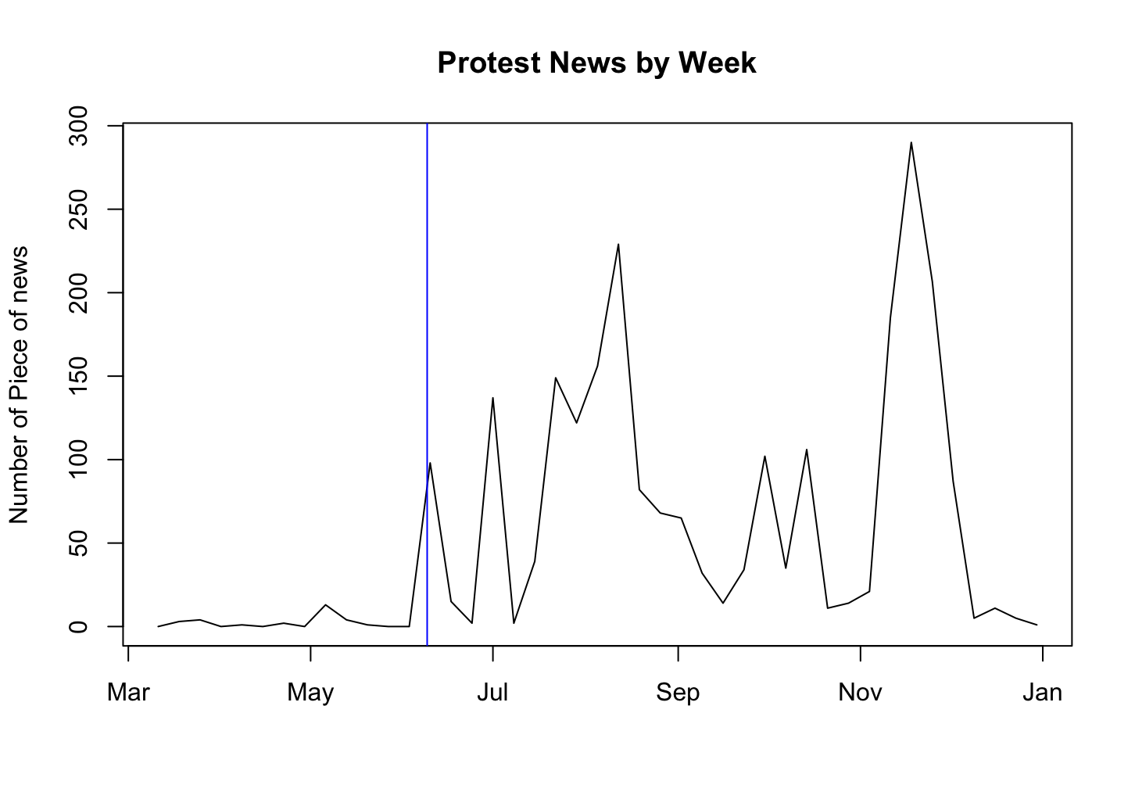
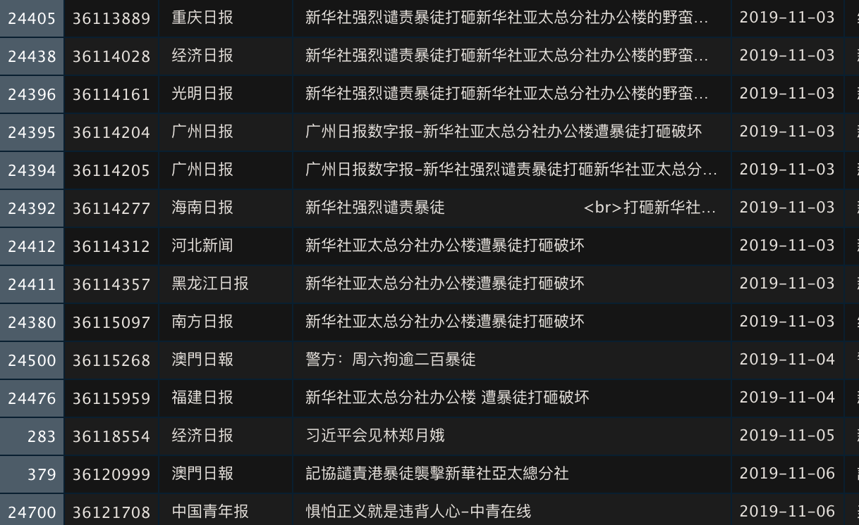
What proportion of articles mentioning Hong Kong are about the protests?
Naive Bayes training
Labeling smaller portion of the articles by hand
Visualization

Slide 5
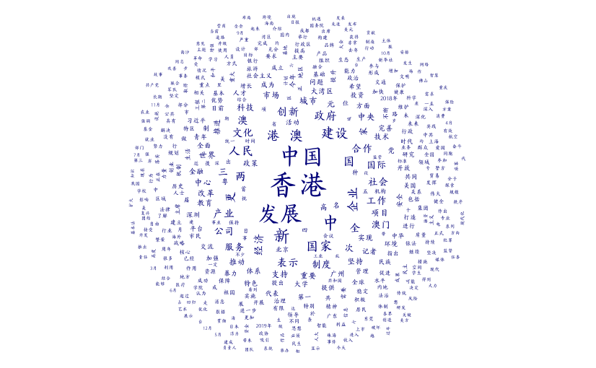
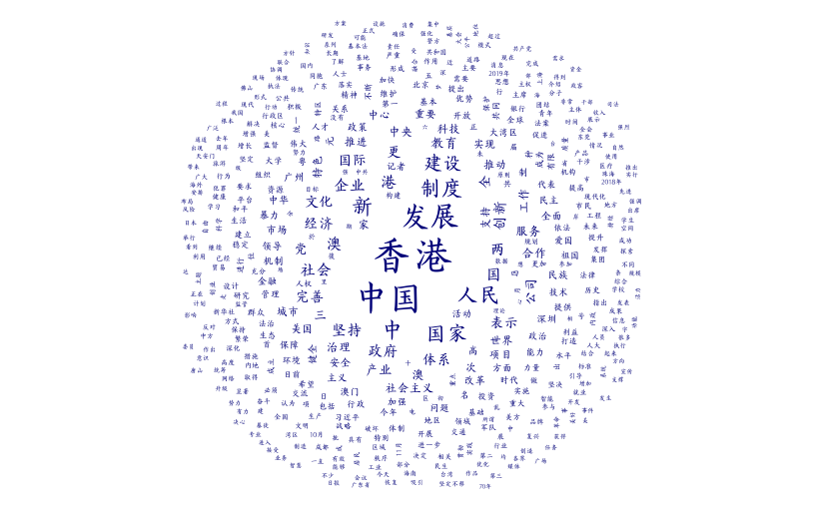
Sentiments
Wordcloud_all
Wordcloud_protest

